Slide 1
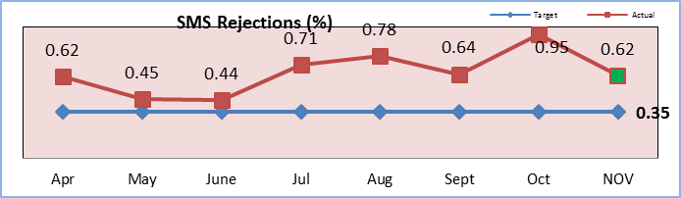
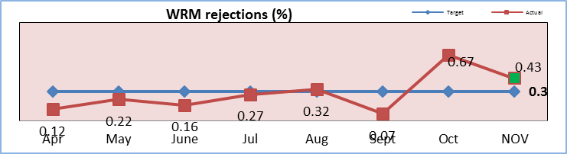
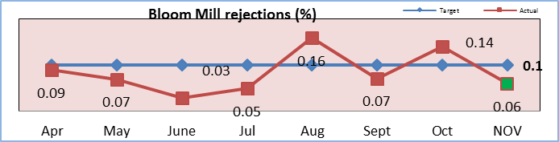
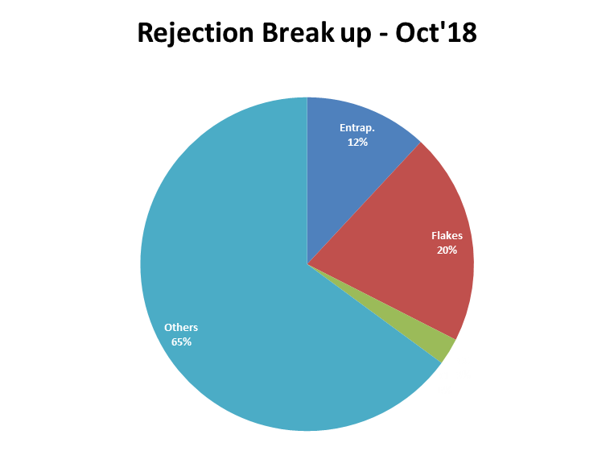
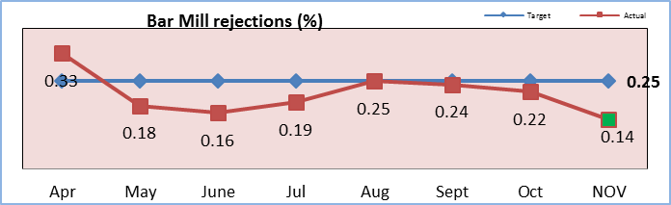
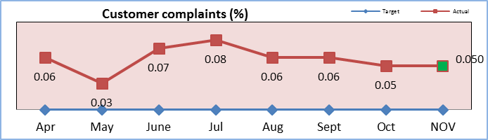
Rejection Trends

Slide 2
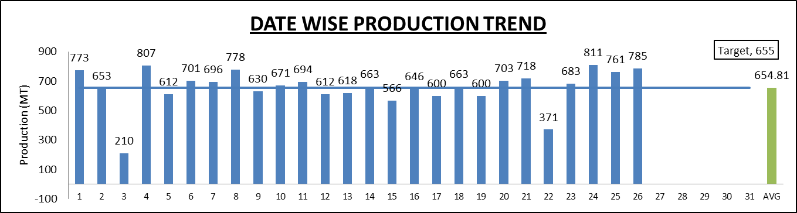
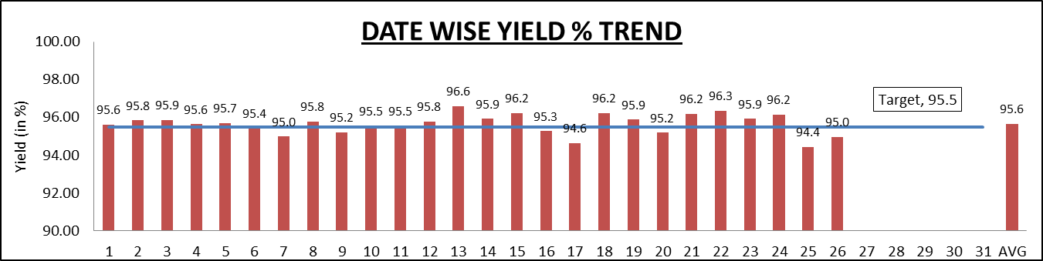
BLOOMING MILL DAILY REPORT – 26/11/18
KPI | TARGET | ON DATE | TILL DATE | ASKING RATE
PRODUCTION (MT) | 19000 | 785 | 16974 | 506
YIELD(%) | 95.5 | 94.97 | 95.58
MILL AVAILABILITY (%) | 80 | 88.54 | 79.35
FO (LT/MT) | 26 | 35.34 | 36.65
POWER (KVAH/MT) | 161 | 127.59 | 149.67

Slide 3
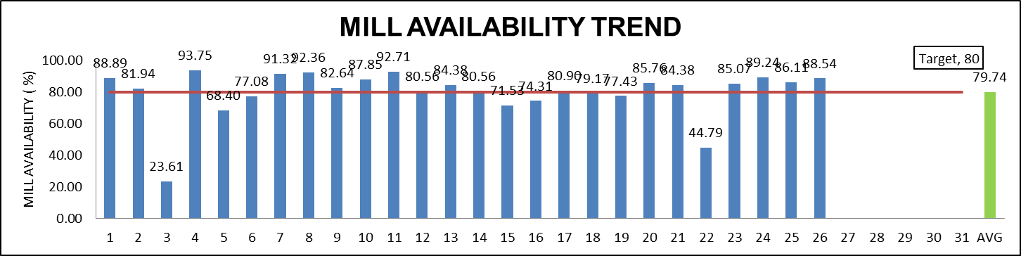
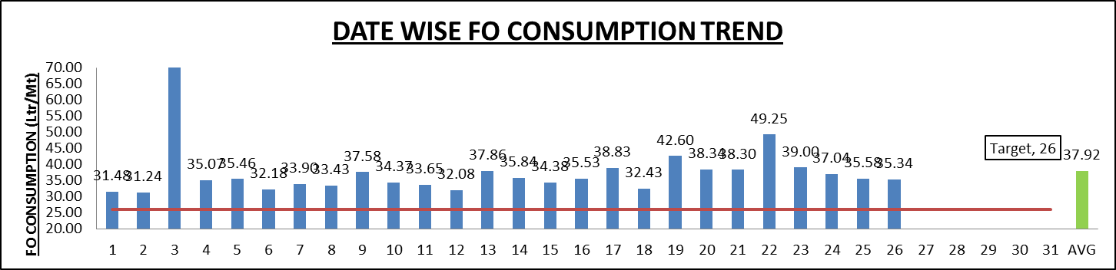
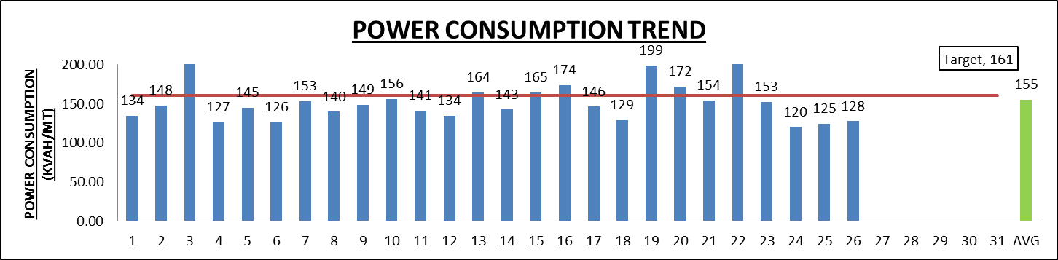

Slide 4
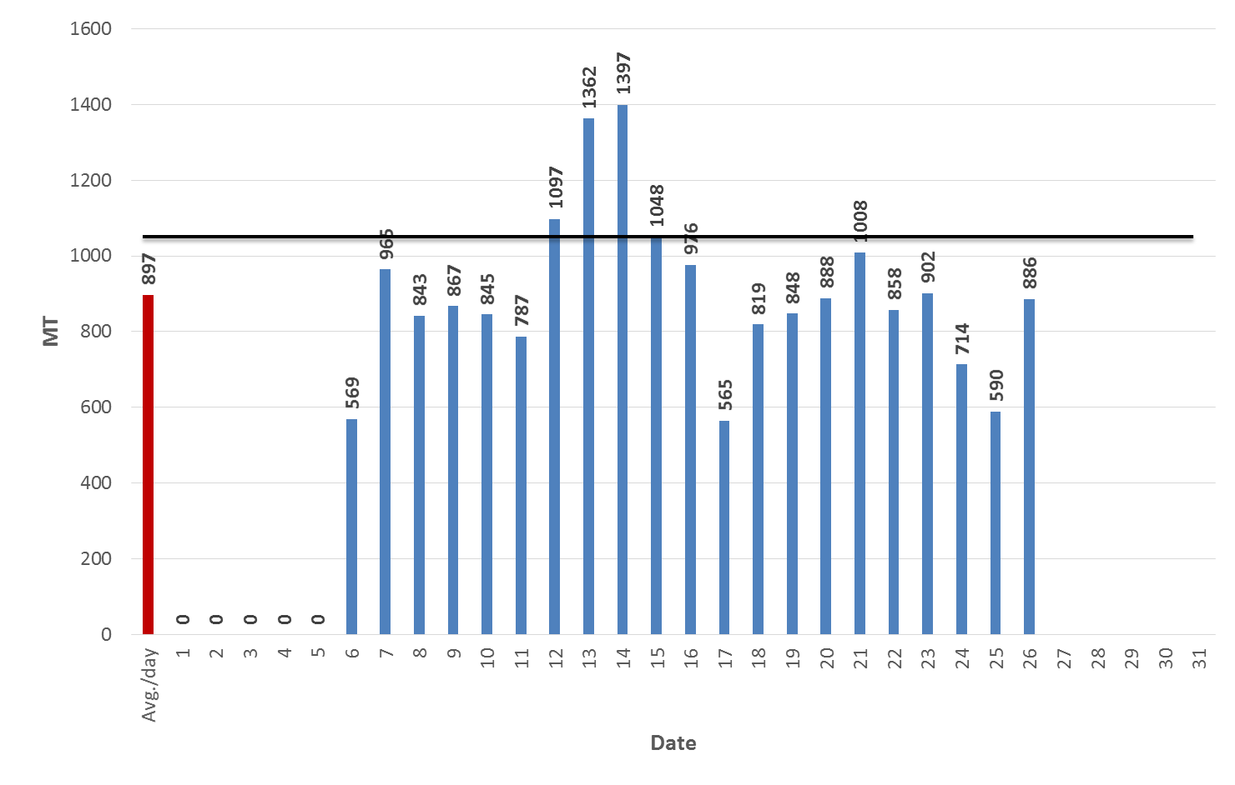
WRM Production
Target : 1040 MT/day

Slide 5
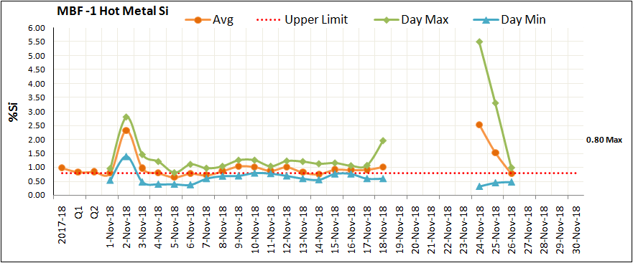
Usha Martin

